Slide 1
Google Data Analytics Certificate – Capstone Project
Case Study:
How Does a Bike-Share Navigate Speedy Success?
Stephen Glover
Last Updated: 07/11/2023

Slide 2
Contents
Business Task
Analysis Results
Visualizations
Recomendations

Slide 3
Business Task
Analyze how casual users and annual members use Cyclistic’s service differently.
Recommend three ways to convert casual users to annual members.

Slide 4
Analysis Results
Key take aways:
Members rent their bicycles for a much shorter amount of time and more often.

Slide 5
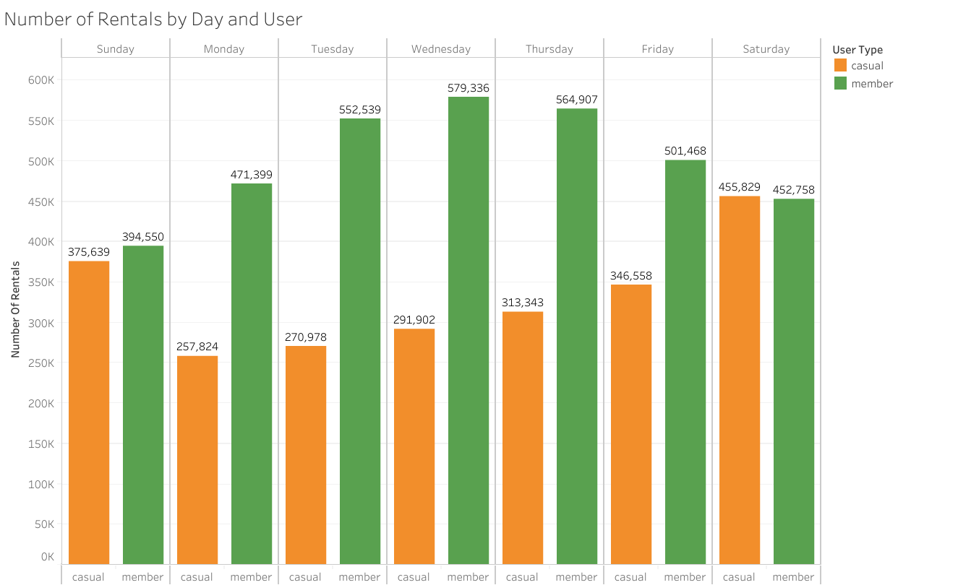
Analysis Results
Key take aways:
Casual users mostly rent on the weekends while members rent more often during the middle of the week.

Slide 6
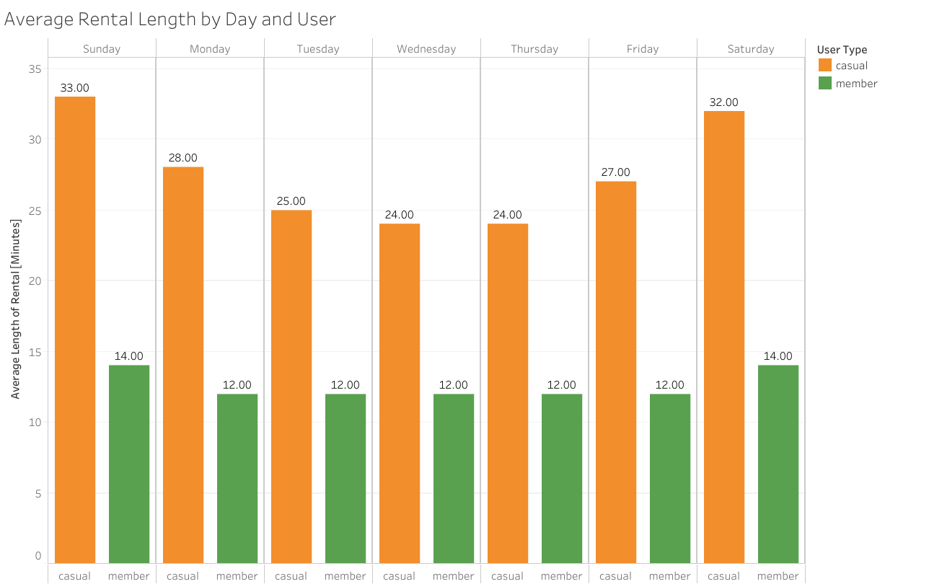
Analysis Results
Key take aways:
Members’ average rental length is consistent throughout the week, while casual users’ rental length peaks on the weekends.

Slide 7
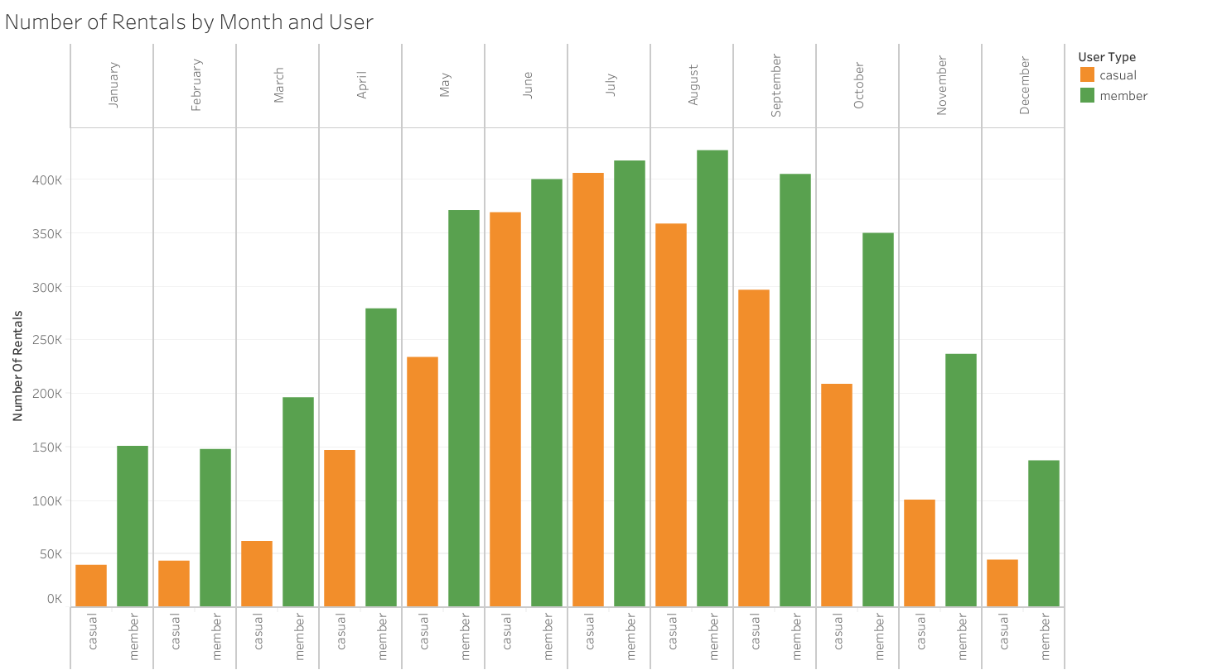
Analysis Results
Key take aways:
Peak months for rentals are during the summer.
Members have a much higher use during the winter months than casual users.

Slide 8
Recommendations
For casual users that are renting for extremely long periods: show them how much money could be saved by using a membership for short trips more often rather than renting for one long period.
For casual users who are renting throughout the middle of the week: show how convenient it is to grab a bike and go as needed with a membership.
For casual users that rent for multiple short periods of time: compare them to annual members and show how much more convenient and cheaper a membership is to having to pay for each individual ride.

